Slide 1
Web Server Hardening Training
From: VISC

Slide 2
Roadmap
0x01
0x02
0x03
0x05
Introduction
Web Server Hardening
How to do it ?
Q&A
0x04
IIS Special Configuration

Slide 3

Server Hardening
Server Hardening is the process of enhancing server security through a variety of means which results in a much more secure operating environment.
Includes:
Server Hardening
Web Server Hardening
We are Here!
Database Hardening

Slide 4



Web Server Hardening
2 Object Levels:
Public Web Server: Web Portal, Mobile TV, Imuzik...
Internal Web Server: BCCS (CC, CM), HR, Voffice…
3 Web Servers:
Apache (A).
Tomcat (T).
IIS (I).

Slide 5
Web Server Hardening (cont)
1
Remove/Disable default components
Secure default Installation configuration
Configure Access Control
Configure Web Server Permission
Securely Installing the Web Server
2
3
4
5
6
7
Configure Logging
Secure SSL/TLS

Slide 6
How do you do?
Hand-on labs

Slide 7
Labs Setup
2 VM:
Linux CentOS 6.4:
Apache.
Tomcat.
Username/password: root/wshclass and tomcat/wshclass.
Windows Server 2008 R2:
IIS 7.5.
Username/password: Administrator/wshclass
All VM use NAT network.

Slide 8
Labs Setup
Configure hosts file (options):
Run notepad as Administrator permission.
Configure host name: Edit file C:\Windows\System32\drivers\etc\hosts
<Windows Server`s IP address> iis.wshclass.com
<Linux Server`s IP address > apache.wshclass.com
<Linux Server`s IP address > tomcat.wshclass.com

Slide 9
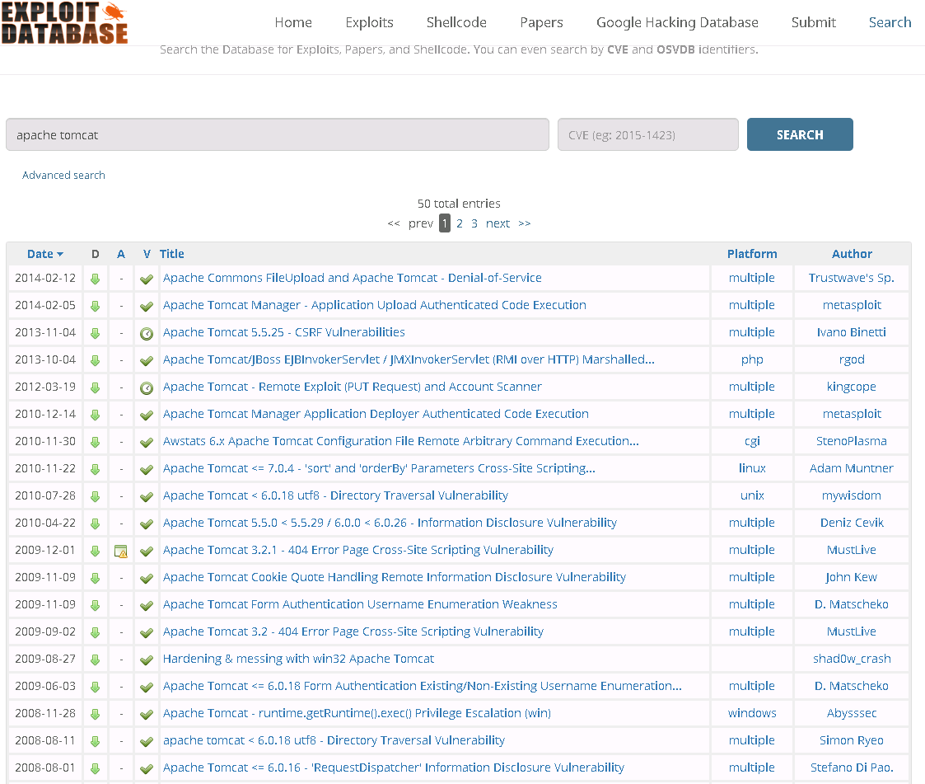

1. Securely Installing the Web Server

Slide 10
1. Securely Installing the Web Server
Web Server Install on Secure Operation System.
Operator System Hardening.
Install permanent fixes (commonly called patches, hotfixes, service packs, or updates)
From VISC`s alert (via VTG).

Slide 11
Tip/Tricks
For new deployment:
Use newest version
Don`t use install package like: xamp, wampp, appserv… (Developer environment)
For old installed:
Apache version: must higher 2.4.12 (2.4.x family) and 2.2.29 (2.2.x family).
Tomcat version: must higher 7.0.63 (Tomcat 7 family) and 6.0.44 (Tomcat 6 family). Don`t use Tomcat 5.

Slide 12
How to check vulnerability version
Get your version
Go to: http://www.cvedetails.com
Search/check your version
Tomcat: http://www.cvedetails.com/version-list/45/887/1/Apache-Tomcat.html
Apache: https://www.cvedetails.com/product/66/Apache-Http-Server.html?vendor_id=45
If found: pleas upgrade now!

Slide 13
Lab exercise 01
10 min!

Slide 14
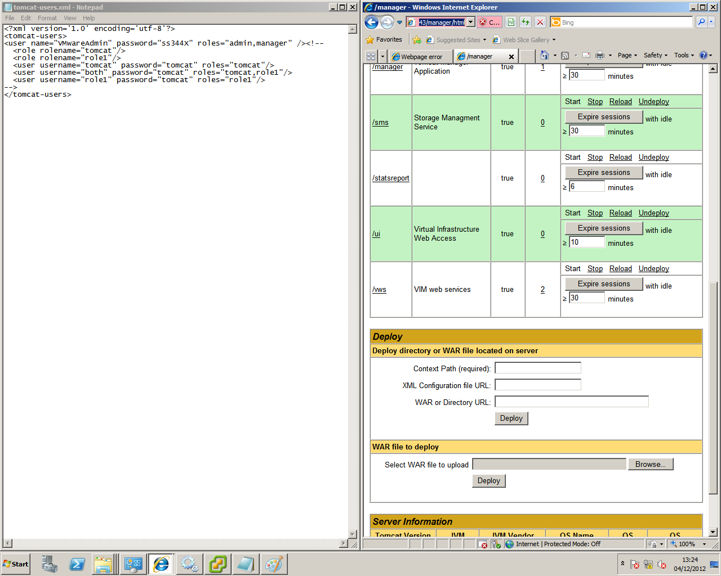
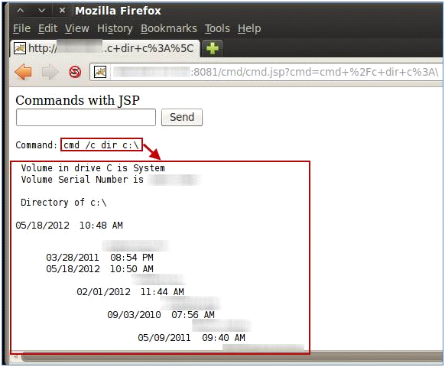
2. Remove/Disable default components
1
Tomcat User Configuaration
Deploy War file
2
3
Tomcat Manage Exploit
Run shell command

Slide 15
2. Remove/Disable default components
Remove default page:
Default page: index.html.
Default Folder: tomcat manager…
Disable/Remove unnecessary Module:
WebDav, CGI, SSI, info…

Slide 16
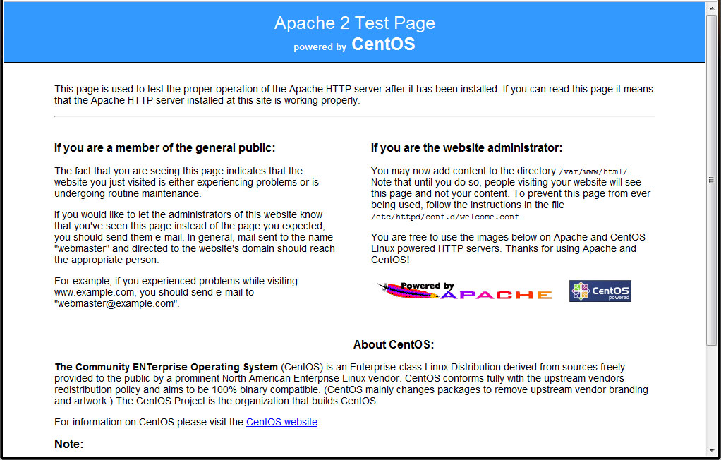
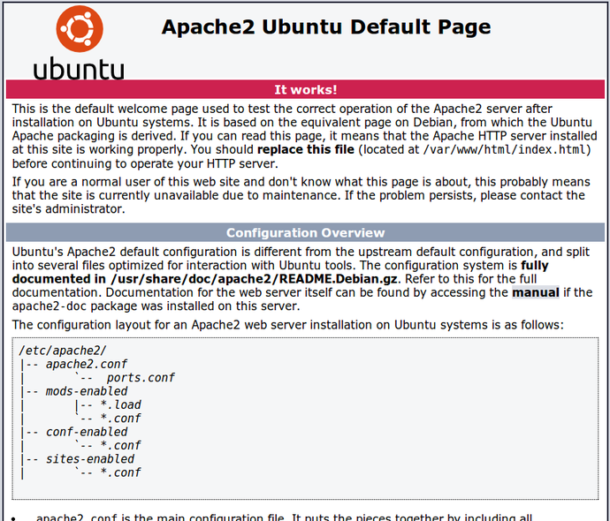
2.1A Remove default page
Apache Guide:
Detect Apache Document Root.
Remove default page.

Slide 17
2.1T Remove default page
Tomcat Guide:
Remove file/folder in CATALINA_HOME/webapps:
ROOT, balancer, jsp-examples, servlet-examples
tomcat-docs, webdav, manager, docs, examples
Remove file:
CATALINA_HOME/conf/Catalina/localhost/host-manager.xml
CATALINA_HOME/conf/Catalina/localhost/manager.xml

Slide 18
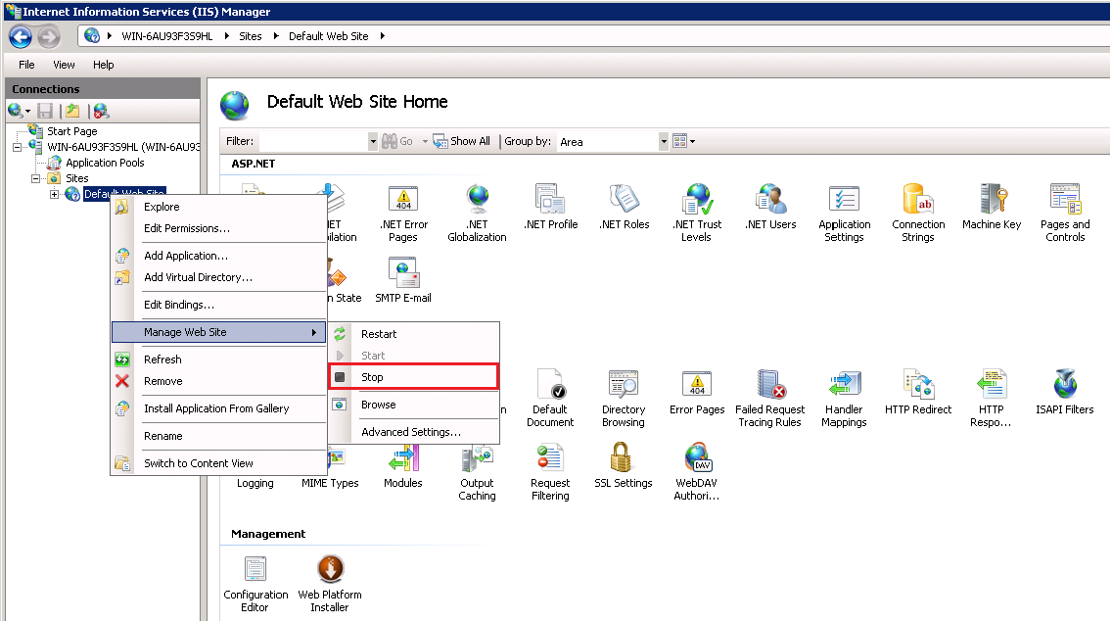
2.1I Remove default page
IIS Guide: Disable Default website
In IIS Manager/Sites, chose Default Web Site.
Right click, chose Manage Web Site/Stop.

Slide 19
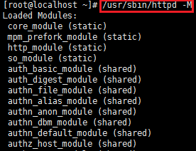
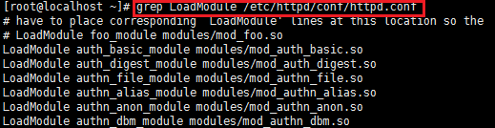
2.2A Disable/Remove unnecessary Extension/Module
Apache Guide:
List loaded module:
/usr/sbin/httpd -M (1)
Or:
grep LoadModule /etc/httpd/conf/httpd.conf (2)
1
2

Slide 20
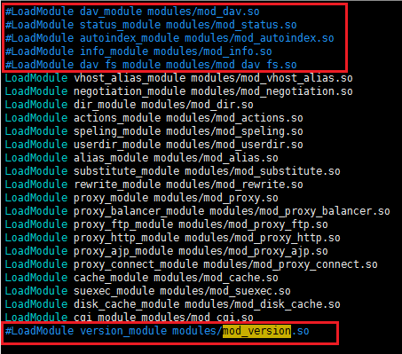
2.2A Disable/Remove unnecessary Extension/Module
Apache Guide:
Uncomment load modules line (unnecessary module)
Ex: mod_info, mod_status, mod_version, mod_autoindex, mod_dav
Restart Apache

Slide 21
2.2T Disable/Remove unnecessary Extension/Module
Tomcat Guide:
Edit file CATALINA_HOME/conf/server.xml.
Find <connector … protocol=”AJP/…”>.
Uncomment it.
Restart Tomcat.

Slide 22
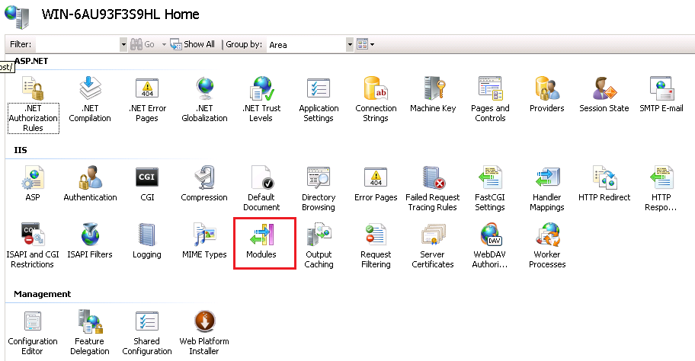
2.2I Disable/Remove unnecessary Extension/Module
IIS Guide:
Open IIS Manager, chose Modules.

Slide 23
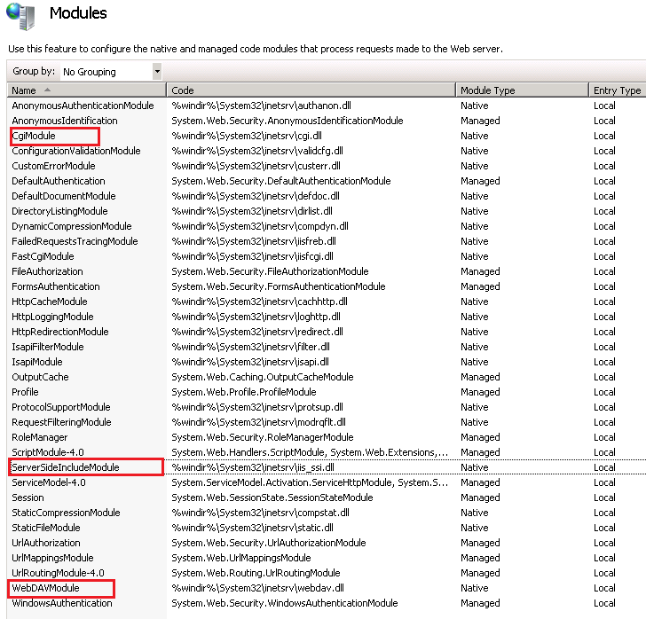
2.2I Disable/Remove unnecessary Extension/Module
IIS Guide (cont):
Remove unnecessary Module:
Cgi Module
Server Side Include Module
WebDav Module

Slide 24
How to check?

Slide 25
Lab exercise 02
15 min!

Slide 26
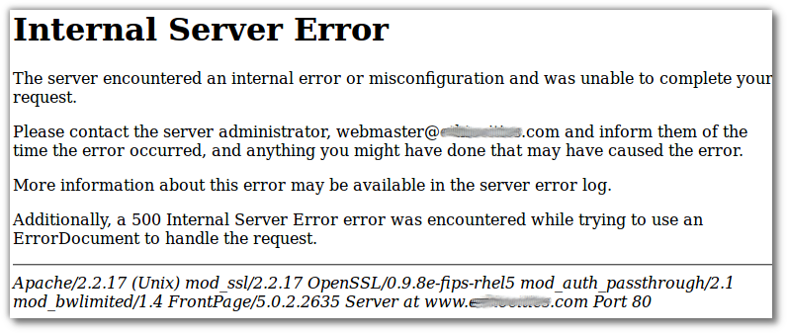
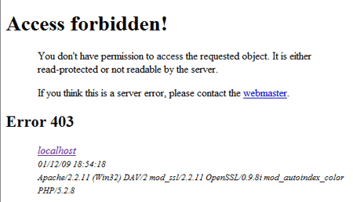
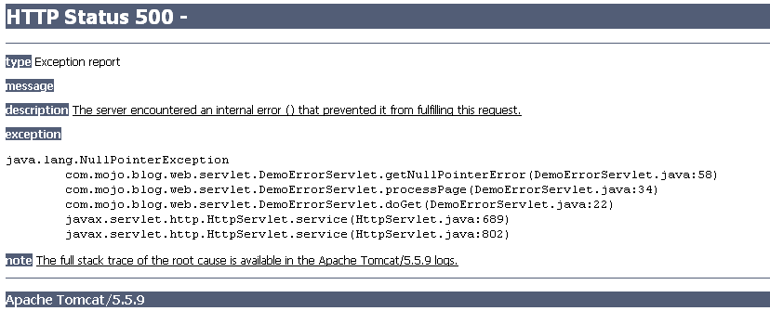
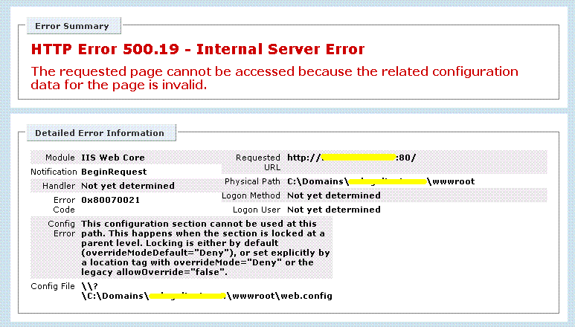
3. Secure default Installation configuration

Slide 27
3. Secure default Installation configuration
Change Default Error page of Web Server.
Note: IIS apply to all website.
Hide Web Server version.
Allow only 3 HTTP Methods:
GET
POST
HEAD

Slide 28
3.1A Change Default Error page of Web Server
Apache Guide:
Create error.html file in Document Root
Add to apache configuration file (http.conf or apache2.conf) (in the right)
Restart Apache
ErrorDocument 400 /error.html
ErrorDocument 401 /error.html
ErrorDocument 402 /error.html
ErrorDocument 403 /error.html
ErrorDocument 404 /error.html
ErrorDocument 500 /error.html
ErrorDocument 501 /error.html
ErrorDocument 502 /error.html

Slide 29
3.1T Change Default Error page of Web Server
Tomcat Guide:
Create error.html file in Document Root of Application.
Edit CATALINA_HOME/conf/web.xml.
Add configuration before </webapp> close tag. (Right)
Restart Tomcat.
<error-page>
<error-code>400</error-code>
<location>/error.html</location>
</error-page>
<error-page>
<error-code>401</error-code>
<location>/error.html</location>
</error-page>
<error-page>
<error-code>402</error-code>
<location>/error.html</location>
</error-page>
<error-page>
<error-code>403</error-code>
<location>/error.html</location>
</error-page>
<error-page>
<error-code>404</error-code>
<location>/error.html</location>
</error-page>
<error-page>
<error-code>500</error-code>
<location>/error.html</location>
</error-page>
<error-page>
<error-code>501</error-code>
<location>/error.html</location>
</error-page>
<error-page>
<error-code>502</error-code>
<location>/error.html</location>
</error-page>
<error-page>
<error-code>403</error-code>
<location>/error.html</location>
</error-page>

Slide 30
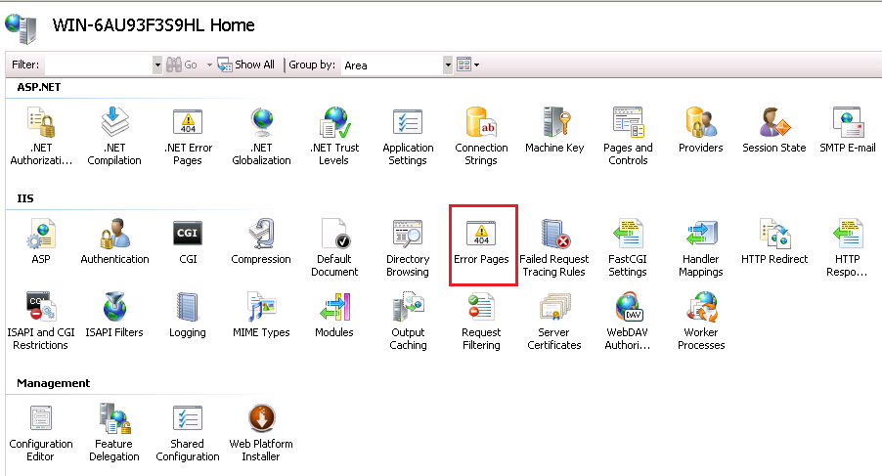
3.1I Change Default Error page of Web Server
IIS Guide:
Create error.html file in C:\inetpub\wwwroot
Open IIS Manager, chose Error Pages:

Slide 31
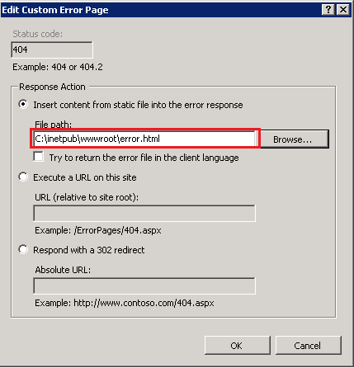
3.1I Change Default Error page of Web Server
IIS Guide (cont):
Chose Edit Feature Settings/ Custom error pages.
Configure like picture.
Chose OK.

Slide 32
3.2A Hide Web Server Version
Apache Guide:
Open Apache configuration file.
Add configuration :
ServerSignature Off
ServerTokens Prod
Restart Apache.

Slide 33
3.3A Allow only 3 HTTP Methods
Apache Guide:
Open Apache configuration file.
Add LimitExcept atribute:
Note: Apply to all directory configuration.
Restart Apache.
<Directory "/var/www/web">
<LimitExcept GET POST HEAD>
Deny from all
</LimitExcept>
...
</Directory>

Slide 34
3.3A Allow only 3 HTTP Methods
Tomcat Guide:
Edit file CATALINA_HOME/conf/web.xml.
Add right config before </webapp> close tag.
Restart Tomcat.
<security-constraint>
<web-resource-collection>
<web-resource-name>restricted methods</web-resource-name>
<url-pattern>/*</url-pattern>
<http-method>PUT</http-method>
<http-method>DELETE</http-method>
<http-method>OPTIONS</http-method>
<http-method>TRACE</http-method>
</web-resource-collection>
<auth-constraint />
</security-constraint>

Slide 35
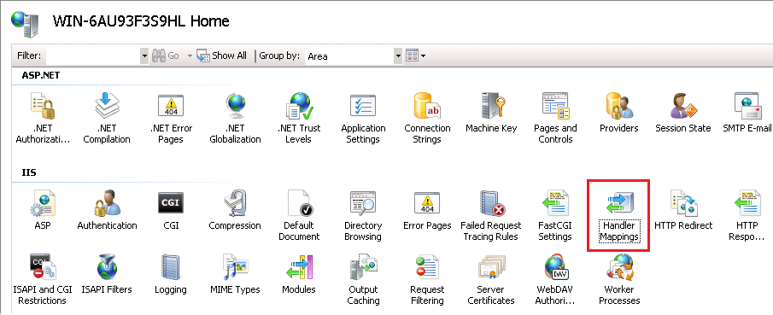
3.3I Allow only 3 HTTP Methods
IIS Guide:
Open IIS Manager, chose Hander Mappings:

Slide 36
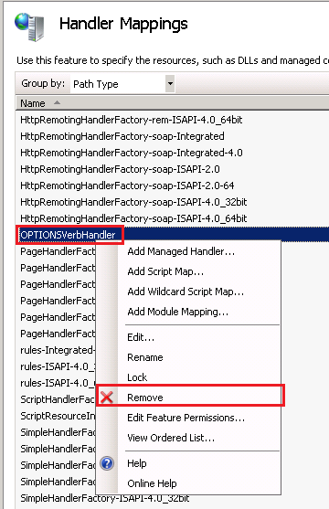
3.3I Allow only 3 HTTP Methods
IIS Guide (cont):
Right click
WebDav.
Traceverbhander.
OptionVerbhander.
Chose Remove.

Slide 37
How to check?

Slide 38
Lab exercise 03
20 min!

Slide 39
4. Configure Access Control
Limit IP access Administrator Page:
Use Web Application feature.
Use OS Firewall: iptables, Windows Advance Firewall.
Disable Directory Browsing.

Slide 40
4.1T Limit IP access Administrator Page
Tomcat Guide:
Edit file CATALINA_HOME/conf/server.xml.
Find SHUTDOWN port.
Change address attribute to 127.0.0.1.
Restart Tomcat.
<Server address="127.0.0.1" port="8005" shutdown="SHUTDOWN">

Slide 41
4.2A Disable Directory Browsing
Apache Guide:
Open configuration file.
Add “-Indexes” to Directory (in Options line).
Notice: apply to all Directory path.
Restart Apache.
<Directory "/var/www/web">
Options -Indexes
</Directory>

Slide 42
4.2T Disable Directory Browsing
Tomcat Guide:
Open file CATALINA_HOME/conf/web.xml.
Find section: <init-param> in <servlet> with <servlet-name>default</servlet-name>
Set listing attribute to false.
Restart Tomcat.
<init-param>
<param-name>listings</param-name>
<param-value>false</param-value>
</init-param>

Slide 43
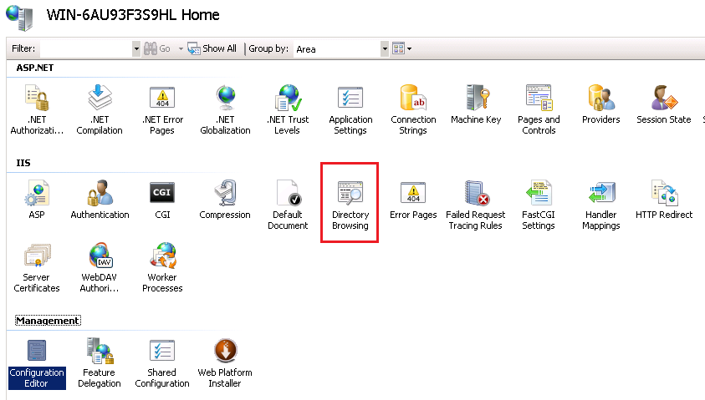
4.2I Disable Directory Browsing
IIS Guide:
In Features View, chose Directory browsing:

Slide 44
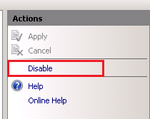
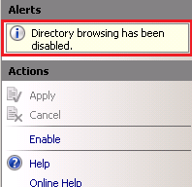
4.2I Disable Directory Browsing
IIS Guide (cont):
Chose Action in top right.
Chose Disable (default is Disable).
Check message “Directory browsing has been disabled” is good.

Slide 45
How to check?

Slide 46
Lab exercise 04
10 min!

Slide 47
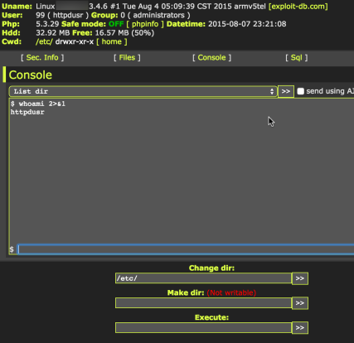
5. Configure Web Server Permission
Run web-shell as Administrator privileges

Slide 48
5. Configure Web Server Permission
Run Webserver with limited privileges user (non-root user).
Disable execute CGI, SSI:
CGI: Common Gateway Interface.
SSI: Server Side Include.

Slide 49
5.1A Run Webserver with limited privileges user
Apache Guide:
Create user www-data to run Apache. (1)
Disable login to www-data. (2)
Configure permission, allow only www-data user, www-data group can edit in web folder (ex: /var/www/html). (3)
useradd –M www-data –s /bin/false
or
useradd –d /dev/null –s /bin/false www-data
1
passwd –l www-data
2
chown -R www-data: www-data /var/www
find /var/www -type d | xargs chmod -R 755
find /var/www -type f | xargs chmod -R 644
chown -R www-data:www-data [cache/session path]
3

Slide 50

5.1A Run Webserver with limited privileges user
Apache Guide (cont):
Configure user run Apache: Open Apache configuration file.
Find: User and Group line.
Change to www-data.
Restart Apache.

Slide 51
5.1T Run Webserver with limited privileges user
Tomcat Guide:
Create new OS user (non-root user).
Login to OS (SSH/Remote Desktop).
Run Tomcat.

Slide 52
5.2A Disable execute CGI, SSI
Apache Guide:
Open Apache configuration file.
Add “ –ExecCGI” attribute to Directory tag (same as above).
Restart Apache.
Notice: Apply to all Directory tag.
<Directory /var/www/web>
Options –ExecCGI -Includes
</Directory>

Slide 53
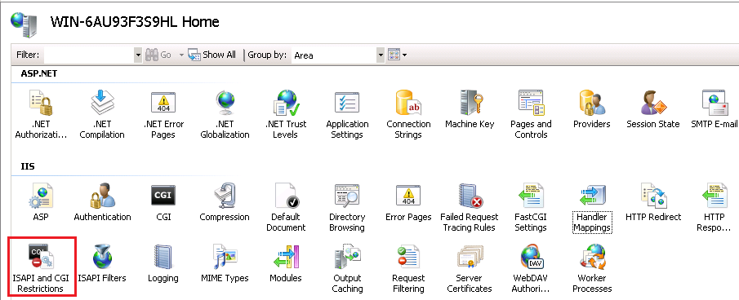
5.2I Disable execute CGI, SSI
IIS Guide:
Disable ASP, CGI, SSI: Enable only ISAPI corresponding with .Net Framework. Disable extension do not use: Active Servers Pages*, WebDav.
In Feature View, chose ISAPI and CGI Restrictions.

Slide 54
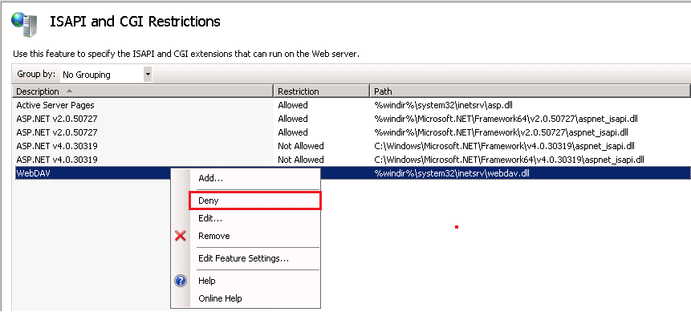
5.2I Disable execute CGI, SSI
IIS Guide (cont):
Chose ISAPI need Disable (ASP, WebDav...). Chose Deny:

Slide 55
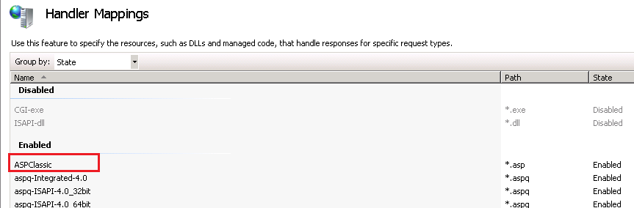
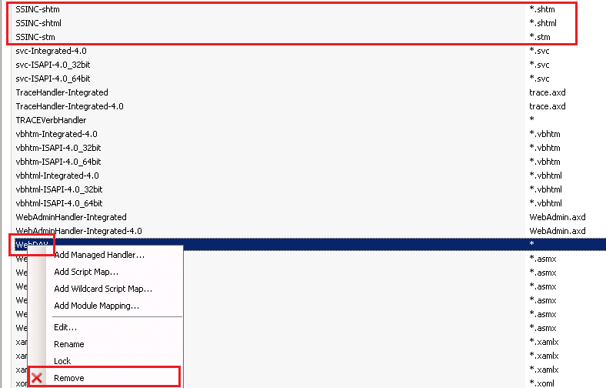
5.2I Disable execute CGI, SSI
IIS Guide (cont):
In IIS Manager, chose Hander Mappings. (1)
Right click to: SSINC-shtm (*.shtm), SSINC-shtml (*.shtml), SSINC-stm (*.stm), WebDav, ASPClassic (*.asp), chose Remove. (2)
Note: Disable ASP dependent application use ASP or not.
1
2

Slide 56
How to check?

Slide 57
Lab exercise 05
20 min!

Slide 58


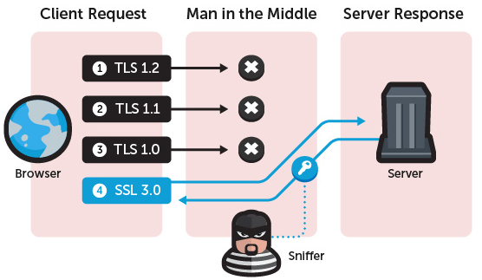
6. Secure SSL/TLS
SSL Hear-bleed.
Did you know ?
And POODLE ?

Slide 59
6. Secure SSL/TLS
Use Security Cryptography Library:
Same as 1.2: Install permanent fixes (commonly called patches, hotfixes, service packs, or updates)
Disable SSLv2.0, SSLv3.0.
Configure security SSL Cipher Suite.

Slide 60

6.2A Disable SSLv2.0, SSLv3.0
Apache Guide:
Find SSL config file:
grep –i –r ”SSLProtocol” /etc/httpd (or apache2.conf)
Open this file.
Change SSLProtocol all (may be have –SSLv2) to:
SSLProtocol all –SSLv2 –SSLv3
Restart Apache.

Slide 61
6.2T Disable SSLv2.0, SSLv3.0
Tomcat Guide:
Open file CATALINA_HOME/conf/server.xml.
Find line: sslProtocols=”TLS”.
Remove it, add: sslEnabledProtocols=”TLSv1, TLSv1.1, TLSv1.2”.
Restart Tomcat.

Slide 62
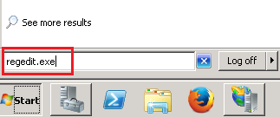
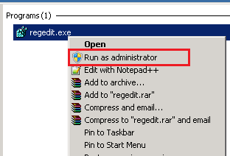
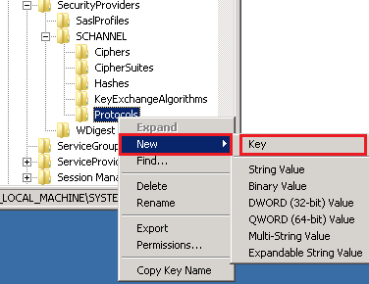
6.2I Disable SSLv2.0, SSLv3.0
IIS Guide:
On Start/Run, type regdit.exe. (1)
Run as Administrator. (2)
Access: HKEY_LOCAL_MACHINE \ System \ CurrentControlSet \ Control \ SecurityProviders \ Schannel \ Protocols \
Protocols, chose New / Key. Name is ”SSL 3.0”. (3)
1
2
3

Slide 63
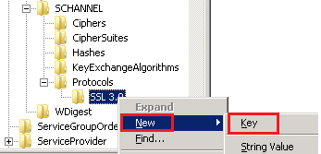
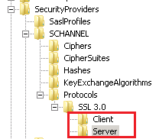
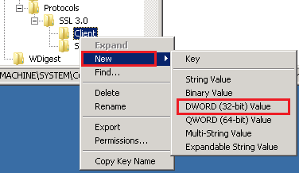

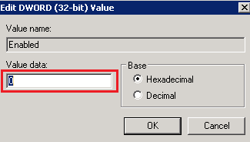
6.2I Disable SSLv2.0, SSLv3.0
IIS Guide (cont):
Right click SSL 3.0, chose New / Key. Name is: Client. (1)
Similar as, create New Key is: Server. (2)
Right click Client, chose New / DWORD (32bit) Value. Name is DisabledByDefault. (3,4)
Right click to it, set value DWORD is 0. (5)
Restart Server.
1
2
3
3
5

Slide 64
6.2A Configure security SSL Cipher Suite
Apache Guide
Find SSLCipherSuite in SSL config file.
Config as:
Restart Apache.
SSLCipherSuite ECDHE-RSA-AES128-GCM-SHA256:ECDHE-ECDSA-AES128-GCM-SHA256:ECDHE-RSA-AES256-GCM-SHA384:ECDHE-ECDSA-AES256-GCM-SHA384:DHE-RSA-AES128-GCM-SHA256:DHE-DSS-AES128-GCM-SHA256:kEDH+AESGCM:ECDHE-RSA-AES128-SHA256:ECDHE-ECDSA-AES128-SHA256:ECDHE-RSA-AES128-SHA:ECDHE-ECDSA-AES128-SHA:ECDHE-RSA-AES256-SHA384:ECDHE-ECDSA-AES256-SHA384:ECDHE-RSA-AES256-SHA:ECDHE-ECDSA-AES256-SHA:DHE-RSA-AES128-SHA256:DHE-RSA-AES128-SHA:DHE-DSS-AES128-SHA256:DHE-RSA-AES256-SHA256:DHE-DSS-AES256-SHA:DHE-RSA-AES256-SHA:!aNULL:!eNULL:!EXPORT:!DES:!RC4:!3DES:!MD5:!PSK:!SSLv3:!SSLv2

Slide 65
6.2T Configure security SSL Cipher Suite
Tomcat Guide:
Open file CATALINA_HOME/conf/server.xml. Go to SSL config.
Config:
Restart Tomcat.
ciphers="TLS_ECDHE_RSA_WITH_AES_128_CBC_SHA256, TLS_ECDHE_RSA_WITH_AES_128_CBC_SHA,TLS_ECDHE_RSA_WITH_AES_256_CBC_SHA384, TLS_ECDHE_RSA_WITH_AES_256_CBC_SHA,TLS_ECDHE_RSA_WITH_RC4_128_SHA, TLS_RSA_WITH_AES_128_CBC_SHA256,TLS_RSA_WITH_AES_128_CBC_SHA,TLS_RSA_WITH_AES_256_CBC_SHA256, TLS_RSA_WITH_AES_256_CBC_SHA,SSL_RSA_WITH_RC4_128_SHA"

Slide 66
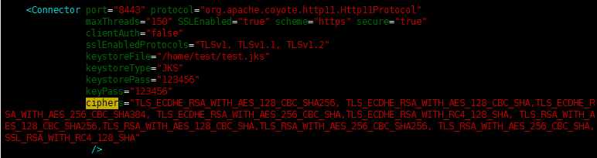
6.2T Configure security SSL Cipher Suite

Slide 67
6.3I Configure security SSL Cipher Suite
IIS Guide:
Run gpedit.exe as Administrator.
In Group Policy Object Editor, chose Computer Configuration / Administrative Templates / Network. Right click SSL Configuration Settings, SSL Cipher Suite Order.
If SSL Cipher Suite Order status is Not Configured → Don`t need config.
If SSL Cipher Suite Order status is Enabled → Remove right cipher in SSL Cipher Suites. (1)
Click OK.
Restart Server.
LS_RSA_EXPORT_WITH_RC4_40_MD5
TLS_RSA_EXPORT1024_WITH_RC4_56_SHA
TLS_RSA_EXPORT1024_WITH_DES_CBC_SHA
SSL_CK_RC4_128_EXPORT40_MD5
TLS_DHE_DSS_EXPORT1024_WITH_DES_CBC_SHA
TLS_RSA_WITH_NULL_MD5
TLS_RSA_WITH_NULL_SHA
TLS_RSA_WITH_NULL_SHA256
TLS_RSA_WITH_NULL_SHA
1

Slide 68
How to check?

Slide 69
Lab exercise 06
30 min!

Slide 70
7. Configure Logging
Synchronize system time.
See OS hardening.
Enable Logging, Log rotate.
Log must enough information to digital forensic.
Log store at least 3 months:
Must enough HDD to store log.

Slide 71
7.3A Enable Logging, Log rotate
Apache Guide:
Go to log access, log error of Apache configuration (key word: CustomLog, ErrorLog).
Edit to:
CustomLog "|/path/to/rotatelogs /path/to/log/httpd/<Tên_APP>_%Y-%m-%d.log 86400" vt_combined
ErrorLog "|/path/to/rotatelogs /path/to/log/httpd/<Tên_APP>_error_%Y-%m-%d.log 86400"

Slide 72

7.3A Enable Logging, Log rotate
Apache Guide (cont):
Restart Apache.
Note: use rotatelogs (of Apache), don`t use logrotate httpd.

Slide 73
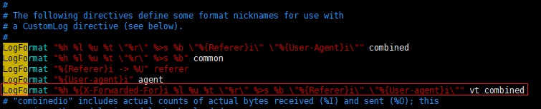
7.3A Log must enough information to digital forensic
Apache Guide:
Open Apache configuration file. Find LogFormat.
Add new LogFormat, name as vt_combined:
Restart Apache
LogFormat "%h %{X-Forwarded-For}i %l %u %t \"%r\" %>s %b \"%{Referer}i\" \"%{User-agent}i\"" vt_combined

Slide 74
7.3A Log must enough information to digital forensic
Tomcat Guide
Open file CATALINA_HOME/conf/server.xml
Add if not exits:
Restart Tomcat
<Valve className="org.apache.catalina.valves.AccessLogValve"
directory="logs"
prefix="<TEN APP>_"
suffix=".log"
pattern="%h %{X-Forwarded-For}i %l %u %t &quot;%r&quot; %s %b &quot;%{Referer}i&quot; &quot;%{User-Agent}i&quot;"
resolveHosts="false"
fileDateFormat="yyyy-MM-dd"
rotatable="true" />

Slide 75
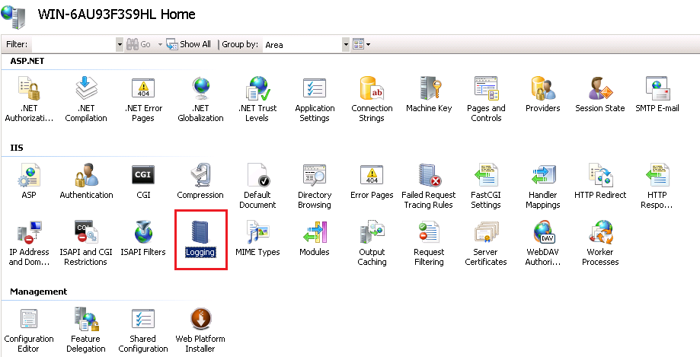
7.3I Enable Logging, Log rotate
IIS Guide:
In IIS Manager, chose Logging:

Slide 76
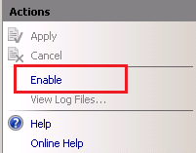
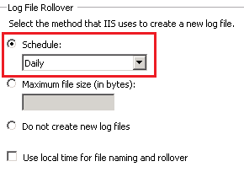
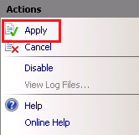
7.3I Enable Logging, Log rotate
IIS Guide:
Click Enable in Action tab (top right). (1)
In Log File Rollover / Schedule, chose Daily. (2)
Click Apply in Action tab to save your configuration. (3)
1
2
3

Slide 77
7.3I Enable Logging, Log rotate
IIS Guide:
In IIS Manager, chose Logging.
In Log file, chose Select Fields: Date, Time, Client IP Address, Username, Server IP Address, Server Port, Method, URI Stem, URI Query, Protocol Status, Protocol Substatus, Win32 Status, Time Taken, User Agent, Referer, Bytes Sent.
If Webserver behind Load Balancing, must use IIS Advanced Logging.

Slide 78
How to check?

Slide 79
Lab exercise 07
30 min!

Slide 80
IIS Special Configurations
IIS Server:
Advanced Logging.
Secure ASP.NET.

Slide 81
IIS Advanced Logging
How to install:
Download from:
http://www.microsoft.com/en-us/download/details.aspx?id=7211 (64bit)
http://www.microsoft.com/en-us/download/details.aspx?id=18374 (32bit)
Install wizard.
Restart IIS.

Slide 82
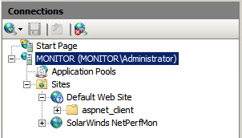
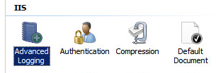
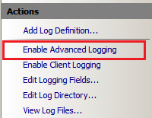
Advanced Logging (1)
How to use:
IIS Manager, chose IIS Server need configure advanced logging. (1)
Chose Advanced Logging. (2)
In top right, chose Enable Advanced Logging. (3)
1
2
3

Slide 83
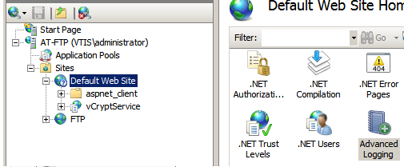
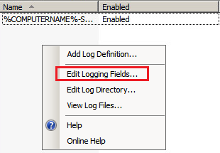

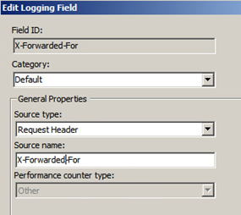
Advanced Logging (2)
How to use:
IIS Manager, chose Web Server need config Advanced Logging. (1)
Right click / Edit Logging Fields (2), chose Add Field. (3)
Register new field: X-Forwarded-For and click OK to save. (4)
1
2
3
4

Slide 84
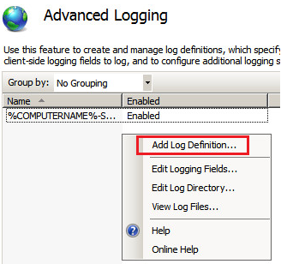
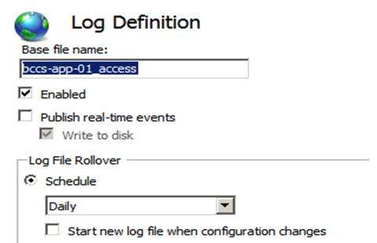
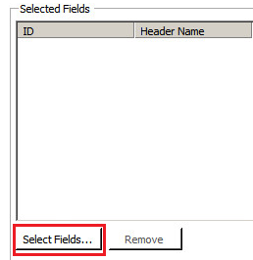
Advanced Logging (3)
How to use:
Right Click, chose Add Log Definition. (1)
Assign Base file name for log file. (2)
Chose Enable / chose Schedule is Daily.
Chose Selected Fields to configure Log Fields. (3)
1
2
3

Slide 85

Advanced Logging (4)
Configure Fields of log file.
In Select Fields, chose all field what you think need.
Note: Chose date/time is Date-Local, Time-Local (use Server Local time).

Slide 86


Advanced Logging (5)
Configure log field order:
In Selected Fields windows, use Move Up/Down/First/Last button to change field order in log file. (1)
Chose Apply to save your config. (2)
1
2

Slide 87



Advanced Logging (6)
Configure separate directory to store log per website:
Right click, chose Edit Log Directory. (1)
Chose Edit Log Directory. (2)
Note: Configure log folder permission, ensure user local “IIS_IUSRS” can read/write. (3)
Restart IIS Server.
1
2
3

Slide 88
Secure ASP.NET
Configure validate data to prevent XSS attack:
Edit web.config (of Website you want configure).
Set validateRequest = "True“.
Save web.config file.
<configuration>
<system.web>
<pages validateRequest="True" />
</system.web>
</configuration>

Slide 89
Secure ASP.NET
Disable Debug mode:
Edit web.config (of Website you want configure).
Set debug=”false”.
Save web.config file.
<system.web>
<compilation debug="false" >
<system.web>

Slide 90
Secure ASP.NET
Change default error page of web application:
Create your custom error page.
Edit web.config (of Website you want configure).
Set customErrors mode is on.
Configure point to your custom error page use defaultRedirect or redirect.
Notice: add more error code: 400, 401,402, 403, 404, 500, 502, 502, 503.
Save web.config file.
<customErrors mode=“On” defaultRedirect="ErrDefault.aspx">
<error statusCode="401" redirect="ErrUnauthorized.aspx" />
<error statusCode="404" redirect="ErrPageNotFound.aspx" />
<error statusCode="500" redirect="ErrServer.htm" />
</customErrors>

Slide 91
Lab exercise 08
30 min!

Slide 92
Q&A

